Slide 1
Chapter 3: Processes

Slide 2
Chapter 3: Processes
Process Concept
Process Scheduling
Operations on Processes

Slide 3
Objectives
To introduce the notion of a process -- a program in execution, which forms the basis of all computation
To describe the various features of processes, including scheduling, creation and termination, and communication

Slide 4
Process Concept
An operating system executes a variety of programs:
Batch system – jobs
Time-shared systems – user programs or tasks
Process – a program in execution; process execution must progress in sequential fashion
A process includes:
program counter
stack
data section
heap

Slide 5
The Process
Multiple parts
The program code, also called text section
Current activity including program counter, processor registers
Stack containing temporary data
Function parameters, return addresses, local variables
Data section containing global variables
Heap containing memory dynamically allocated during run time
Program is passive entity, process is active
Program becomes process when executable file loaded into memory
Execution of program started via GUI mouse clicks, command line entry of its name, etc
One program can be several processes
Consider multiple users executing the same program

Slide 6
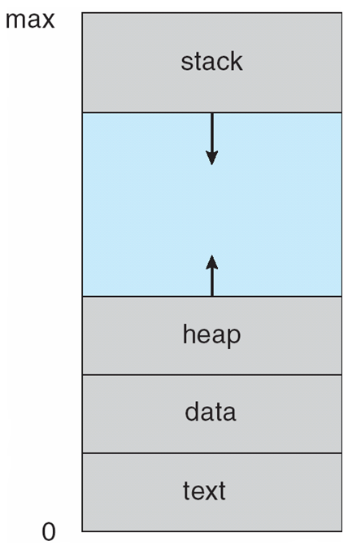
Process in Memory

Slide 7
Process management
The OS manages processes by:
Creating and deleting processes
Suspending and restarting processes
Assigning resources to processes
Scheduling processes
Synchronizing processes
Providing communication between processes

Slide 8
Process State
As a process executes, it changes state
new: The process is being created
running: Instructions are being executed
waiting: The process is waiting for some event to occur
ready: The process is waiting to be assigned to a processor
terminated: The process has finished execution

Slide 9
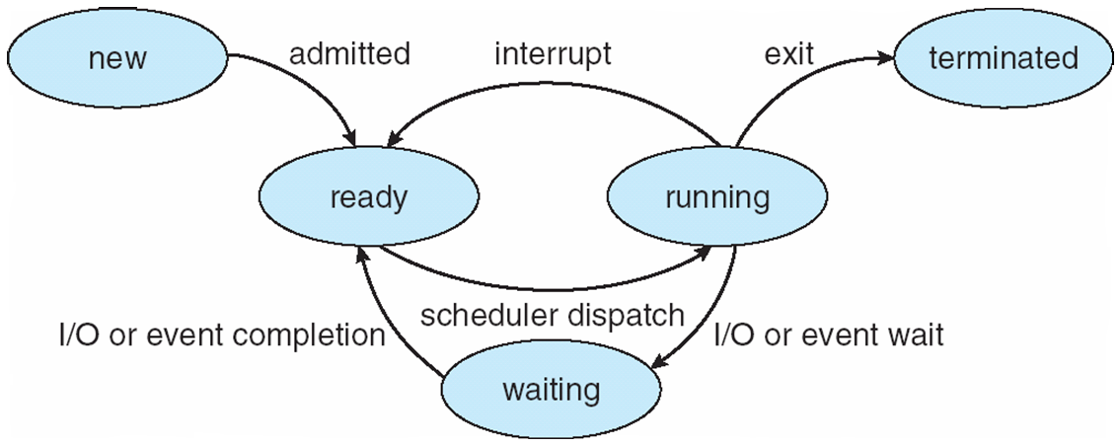
Diagram of Process State

Slide 10
Process Control Block (PCB)
The Operating System at all times has a table called the process table
Information associated with each process
Process ID
Process state
Program counter
CPU registers
CPU scheduling information
Memory-management information
Accounting information
I/O status information

Slide 11
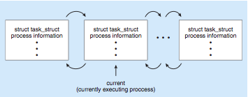
Process Representation in Linux
Represented by the C structure task_struct
pid t_pid; /* process identifier */
long state; /* state of the process */
unsigned int time_slice /* scheduling information */
struct task_struct *parent; /* this process’s parent */
struct list_head children; /* this process’s children */
struct file_struct *files; /* list of open files */
struct mm_struct *mm; /* address space of this process */

Slide 12
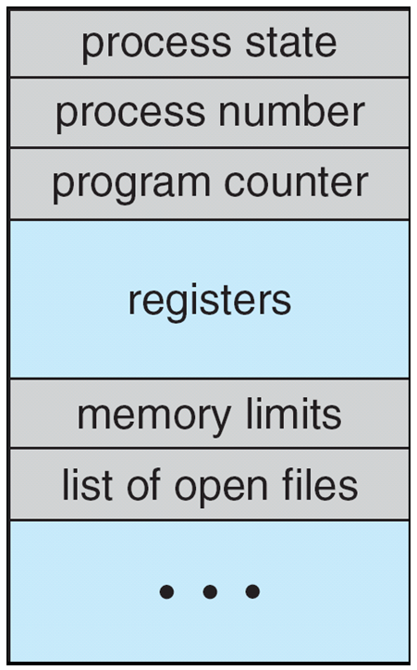
Process Control Block (PCB)

Slide 13
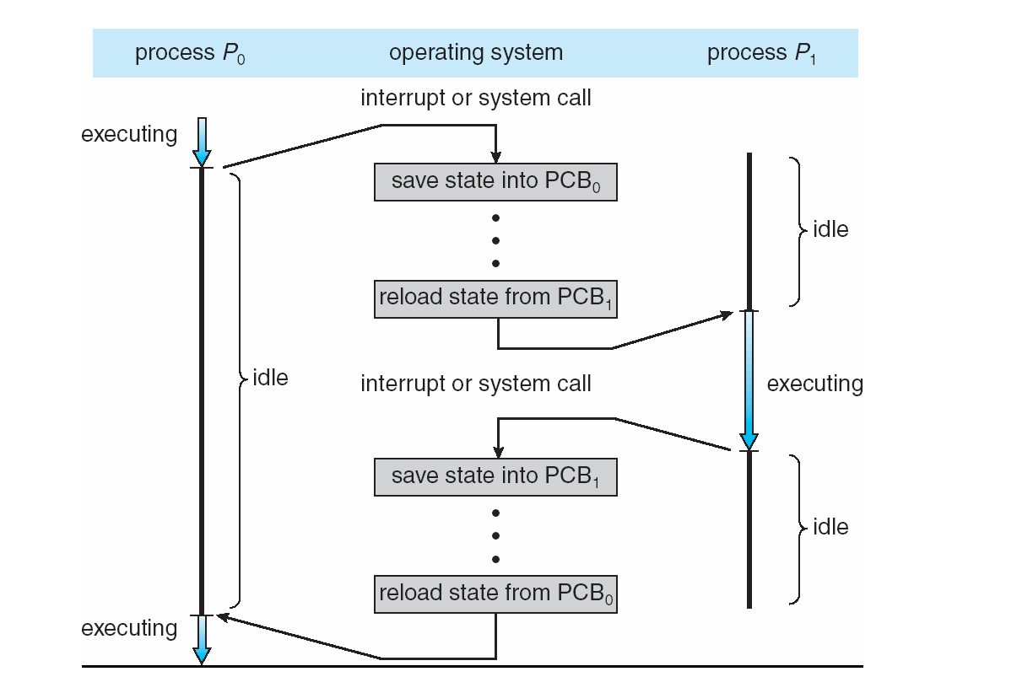
CPU Switch From Process to Process

Slide 14
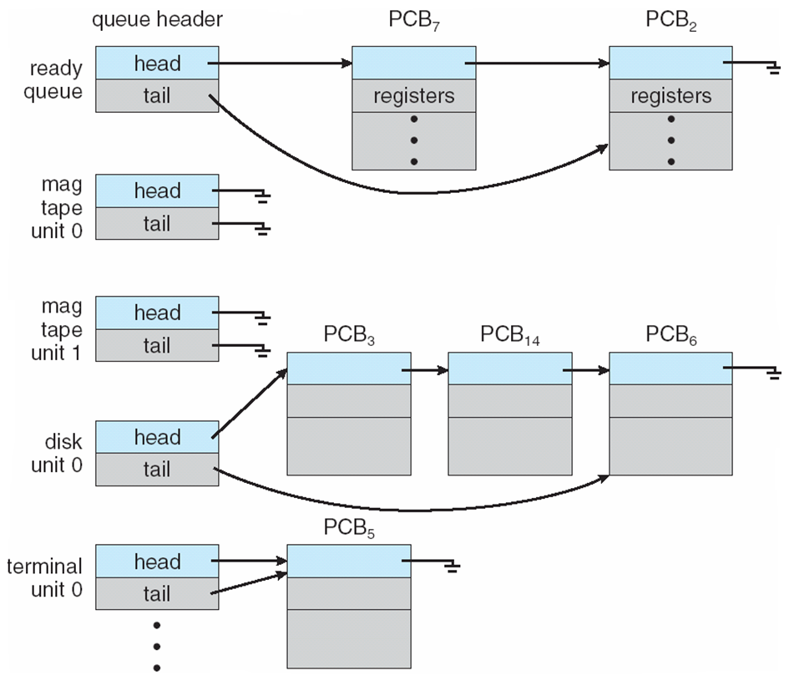
Ready Queue And Various I/O Device Queues

Slide 15
Process Scheduling
Maximize CPU use, quickly switch processes onto CPU for time sharing
Process scheduler selects among available processes for next execution on CPU
Maintains scheduling queues of processes
Job queue – set of all processes in the system
Ready queue – set of all processes residing in main memory, ready and waiting to execute
Device queues – set of processes waiting for an I/O device
Processes migrate among the various queues

Slide 16
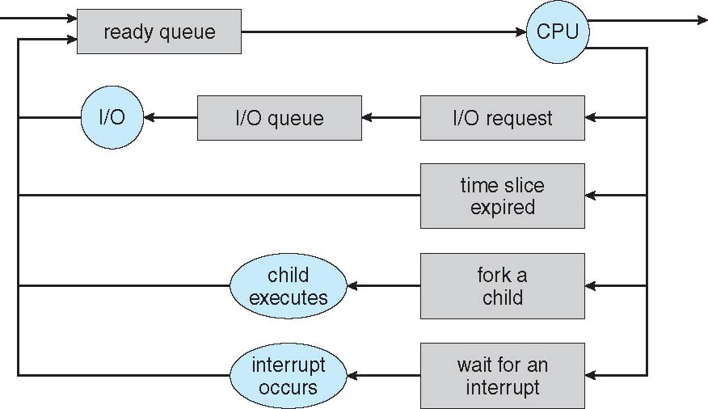
Representation of Process Scheduling
Queuing diagram

Slide 17
A new process scheduling
A new process is initially put in ready queue
Once the process is allocated the CPU and is executing, one of the following events could occur
The process could issue an I/O requests
Placed in I/O queue
The process could create a new subprocess and wait for the subprocess’s termination
The process could be removed forcibly from the CPU and be put back in ready queue

Slide 18
Schedulers
Long-term scheduler (or job scheduler) – selects which processes should be brought into the ready queue
Short-term scheduler (or CPU scheduler) – selects which process should be executed next and allocates CPU
Sometimes the only scheduler in a system

Slide 19
Schedulers (Cont.)
Short-term scheduler is invoked very frequently (milliseconds) ⇒ (must be fast)
Long-term scheduler is invoked very infrequently (seconds, minutes) ⇒ (may be slow)
The long-term scheduler controls the degree of multiprogramming
Processes can be described as either:
I/O-bound process – spends more time doing I/O than computations, many short CPU bursts
CPU-bound process – spends more time doing computations; few very long CPU bursts

Slide 20
Schedulers (Cont.)
Criteria for CPU scheduling
Maximization
CPU utilization
Throughput
Number of processes per unit time
Minimization
Waiting time
Time spent waiting in the ready queue
Response time
For interactive systems

Slide 21
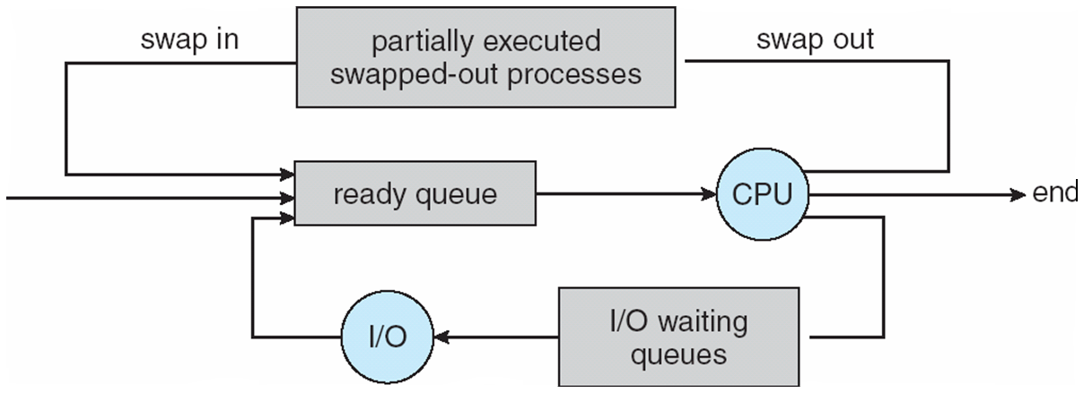
Addition of Medium Term Scheduling

Slide 22
Context Switch
When CPU switches to another process, the system must save the state of the old process and load the saved state for the new process via a context switch.
Context switch of a process represented in the PCB
Context-switch time is overhead; the system does no useful work while switching
The more complex the OS and the PCB -> longer the context switch
Time dependent on hardware support
Some hardware provides multiple sets of registers per CPU -> multiple contexts loaded at once

Slide 23
Context Switch
When CPU switches to another process, the system must save the state of the old process and load the saved state for the new process
P1 has CPU
OS has CPU
P2 has CPU
Save state of P1
Service interrupt
Select next
user process P2
Restore state of P2 and restart CPU
Context switch

Slide 24
Process Creation
When are processes created?
On system startup. Daemons, or background processes, are automatically started by the Operating System when the system is initialized and they work in the background either listening for events to occur or maintaining some part of the system.
On system calls. A process that is already running may wish to give birth to additional processes to help it in a particular task. The latter processes are known as child processes and the former is the parent. It is common to have such a hierarchy of processes.
On user requests. Double clicking on a program icon or executing it via the command line automatically creates a process for that program. It is more than likely that it will then generate child processes to perform separate tasks.

Slide 25
Process Creation
Parent process create children processes, which, in turn create other processes, forming a tree of processes
Generally, process identified and managed via a process identifier (pid)
Resource sharing
Parent and children share all resources
Children share subset of parent’s resources
Parent and child share no resources
Execution
Parent and children execute concurrently
Parent waits until children terminate

Slide 26
Process Creation (Cont.)
Address space
Child duplicate of parent
Child has a program loaded into it
UNIX examples
fork system call creates new process
exec system call used after a fork to replace the process’ memory space with a new program

Slide 27
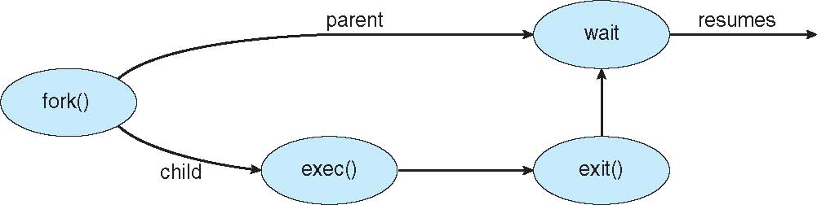
Process Creation

Slide 28
C Program Forking Separate Process
#include <sys/types.h>
#include <stdio.h>
#include <unistd.h>
int main()
{
pid_t pid;
/* fork another process */
pid = fork();
if (pid < 0) { /* error occurred */
fprintf(stderr, "Fork Failed");
return 1;
}
else if (pid == 0) { /* child process */
execlp("/bin/ls", "ls", NULL);
}
else { /* parent process */
/* parent will wait for the child */
wait (NULL);
printf ("Child Complete");
}
return 0;
}

Slide 29
Creating Processes using UNIX and C
With the statement pid= fork() a child process is created. The function fork returns an integer equal to 0 to the child process and one different from 0 to the parent process.
The execlp system calls is used after a fork system call by one of processes to replace the process’ memory space with a new program
The parent waits for the child process to complete with the wait system call

Slide 30
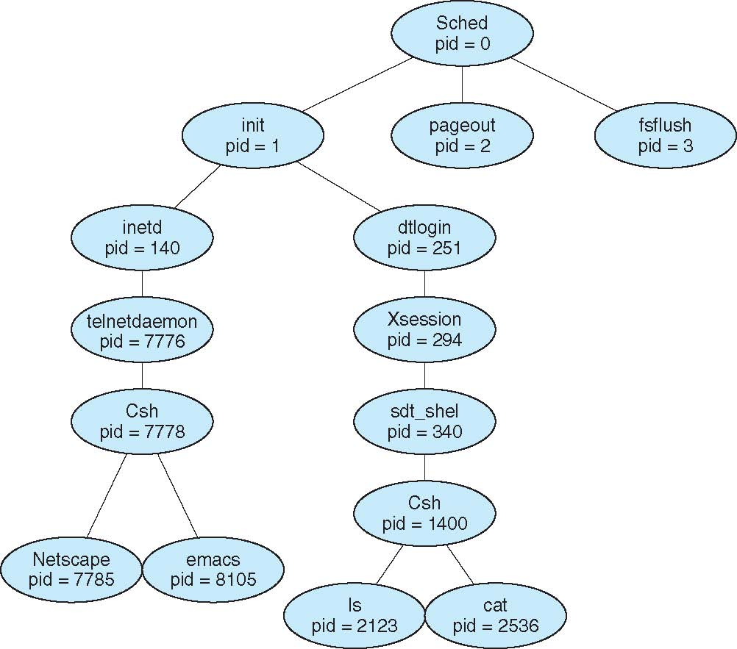
A Tree of Processes on Solaris
Unique pid’s
• Parent-child relationships are recorded
• Orphants are attached to the system ‘grandfather’ called init (process # 1)
• init is also the process that initiates the login of new users
• System services are processes started by init, by themselves capable of starting new ones
• Network services are executed under control of inetd (the internet daemon)
– e.g. RPC support, ftp, telnet, rlogin etc.

Slide 31
Process Termination
When are processes terminated?
When they're done. After it completes its tasks, a process voluntarily exits.
When an error occurs. If an error occurs that the process cannot ignore or avoid, it voluntarily exits.
When a fatal error occurs. A program directly referencing memory (in a language such as C, which allows this) may be referring to data that is nonexistent. In such a case, the system has no option but to kill the process to prevent it from corrupting other processes' data.
When killed by another process.

Slide 32
Process Termination
Process executes last statement and asks the operating system to delete it (exit)
Output data from child to parent (via wait)
Process’ resources are deallocated by operating system
Parent may terminate execution of children processes (abort)
Child has exceeded allocated resources
Task assigned to child is no longer required
If parent is exiting
Some operating systems do not allow child to continue if its parent terminates
All children terminated - cascading termination

Slide 33
Creating Processes using UNIX and C
#include<stdio>
int main()
{
int pid;
/* fork another process */
pid = fork();
if (pid < 0) { /* error occurred */
fprintf(stderr, "Fork Failed");
exit(-1);
}
else if (pid == 0) /* child process */
{
fprintf(“Hello from child 1\n”);
exit (0);
}
else
printf(“Hello from parent\n”);
}
100
0

Slide 34
Creating Processes using UNIX and C
With the statement pid= fork() this program creates a child process. The function fork returns an integer equal to 0 to the child process and one different from 0 to the parent process.
The if statement prevents the parent process from executing the print “Hello from child 1” statement since to the parent process pid is not 0. The parent process only executes the print “Hello from parent” statement.
The child process only executes the print “Hello from child 1” statement.

Slide 35
Creating Processes using UNIX and C
Assume the following program contains no syntax errors. As it executes it will create one or more processes. Simulate the execution of this program and show how processes are created
#include<stdio.h>
main()
{
int p1=1, p2=2, p3=3;
p1 = fork();
if(p2>0) p2 = fork();
if(p1>0) p3 =fork();
if(p1==0) printf(“type 1”);
if(p3!=0) printf(“type 2”);
if(p2!=0) printf(“type 3”);
if((p1>0)||(p2>0) || p3>0)) printf(“type 4”);
if((p2==0) && (p3==0)) printf(“type 5”);
}
Also answer the following question
How many times will this program print the following?
“Type 1” ______3__________
“Type 2” ______9_________
“Type 3” ______7__________
“Type 4” ______11__________
“Type 5” ______1_________

Slide 36
Creating Processes using UNIX and C
The following program contains no syntax errors. As it executes it will create one or more processes. Simulate the execution of this program and show how processes are created
#include<stdio.h>
main()
{
int x, y, count;
count =1; x=10; y=10;
while (count < 3)
{
if(x != 0) {
x = fork(); y = y + 10;}
else{
x = fork(); y = y+50;}
printf(“ y = %d”, y);
count = count + 1;
}
}
The total number of created processes including the parent process is ___________
What will this program print on screen when it is executed?
________________
________________
________________
________________
________________
________________

Slide 37
End of Part 1 of Chapter 3

